Slide 1

console.Coders
Aryaman Chokhani
Darshit Bhagtani
Sujal Choradia
SORT MY EVENT
“Comfort Comes First”

Slide 2

Problem Statement
Standing in the queue waiting for the tickets for your favorite show but
still not getting the tickets at the end is so frustrating. But what if we
could just book tickets for our favourite shows with the same comfort
with which we make plans for it .
What if I say no contacts and advertisements were required for organizing
events. Just surf on digitally, select your location, set your date and time
with the type of event, add a little description to make the users attract
and get your tickets sold .
Keeping a collection on the users and organizers data, the statistics add
verifying to give access to the organizers is the power of the admin .
The end users are the customers that will purchase tickets for the events
that are organised by the organizers who are verified by the admin.

Slide 3

Solution
The website that provides this interface and comfort for all users is “Sort My Event" .
“Sort My Event" is the website which not only allows to book events
but also to organize events related to:
educational
music festivals and concerts
comedy shows
theaters
Sort My Event has 3 modules:-
a) Admin that can view all events revoke or provide access to organizers on verification and keep a check on the statistics .
b)Organizers can edit, delete, create & view events after
signing up and being verified by the admin .
c)Customer can sign up or login and purchase the events
presented by the organizers .

Slide 4



Tech Stack
Interface
HTML
Node JS
Database
Mongo DB
Designing Tools
CSS
Draw.io

Slide 5
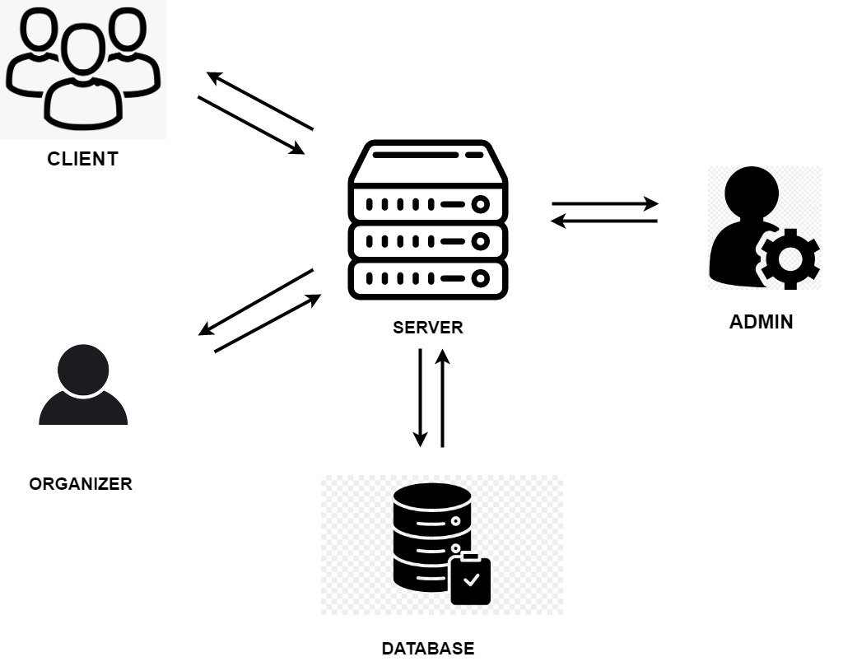

Architectural diagram

Slide 6
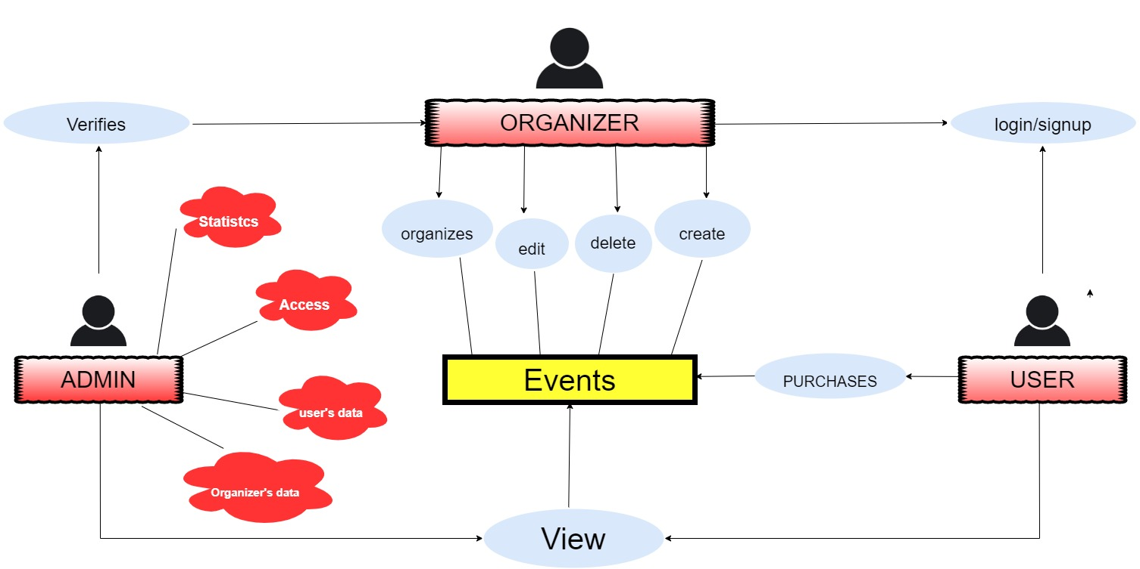

Slide 7
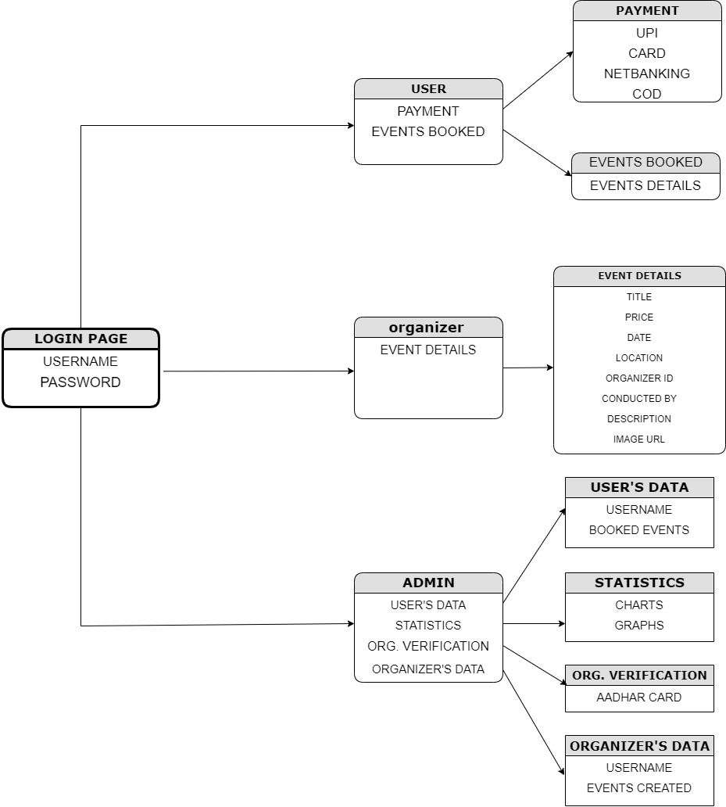
Database Design

Slide 8

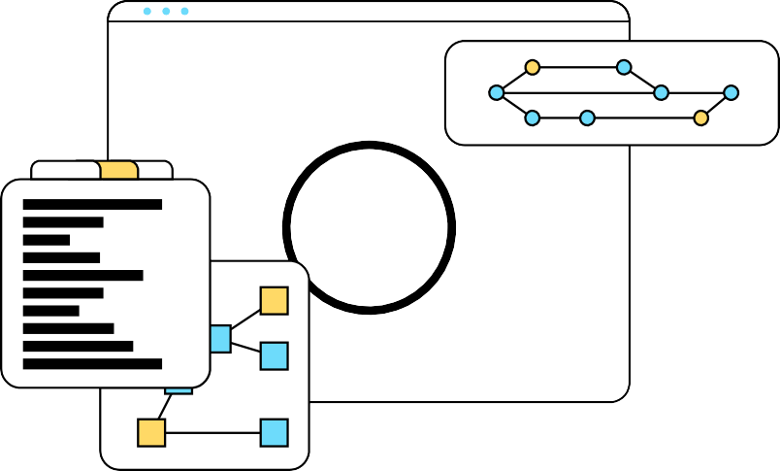


Future Scope
SEARCH bar
Navigating through search bar for events that will be listed by the organizers.
Likes
Each user can drop likes on their favourite events and get updates whenever the organizer hosts the events.
Reviews
A section where can the users can provide reviews for the events listed.
Better features for events
The organizer gets features to provide live stream events and recommend events to the user with the help of AI . Offers and gift cards will also be included.

Slide 9
Thank you
Adapt it with your needs and it will capture all the audience attention.

